Slide 1
Developing custom solutions for SharePoint Online in Azure
Peter Lasne

Slide 2

Peter Lasne
pelasne@microsoft.com
Cloud Solutions Architect Microsoft
Manager, Collaborative Services SPX
Director, Web & Application Development MedCath

Slide 3
What is Azure AND why do I want to use it for SharePoint Development?

Slide 4
On-Premises
Infrastructure-as-a-Service
Platform-as-a-Service
Software-as-a-Service
Data
Application
Runtime
Middleware
O/S
Virtualization
Server
Storage
Networking
Data
Application
Runtime
Middleware
O/S
Virtualization
Server
Storage
Networking
Data
Application
Runtime
Middleware
O/S
Virtualization
Server
Storage
Networking
Data
Application
Runtime
Middleware
O/S
Virtualization
Server
Storage
Networking
Azure
greater control / higher cost
lower cost / greater value

Slide 5

























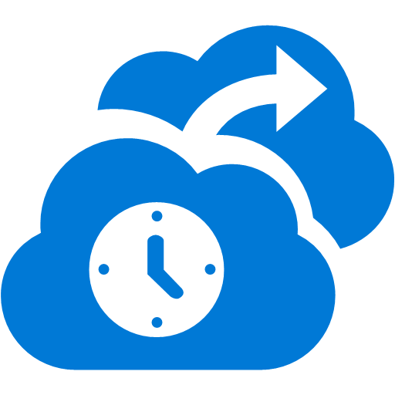



















Azure services
COMPUTE
NETWORKING
IDENTITY & ACCESS
MEDIA & CDN
Virtual
Machines
Cloud
Services
Batch
Scheduler
Remote App
Virtual
Network
Express
Route
Traffic
Manager
Active
Directory
Multi-Factor
Authentication
Media
Services
Content Delivery
Network (CDN)
Get full control over a server in the cloud and maintain it as your business requires.
Managed Virtual Machines with specific web and worker roles that are stateless
For running large scale parallel and high performance computing (HPC) applications
Create jobs that run reliably on simple or complex schedules to invoke any type of service.
Access Windows apps that run within the Service on VM’s from any device and any location.
Provision and manage VPNs in Azure and securely link to your on-premises IT infrastructure.
Connect on-premises and cloud data centers directly through dedicated, non-internet lines.
Load-balance incoming global traffic across multiple services running in multiple data centers.
Identity and access management for cloud applications and ability to link to on-premises Server AD.
Safeguard access to data and apps with additional physical layer of security control.
Range of services that support video on-demand and live streaming workflows.
Cache content for your apps at 100’s of edge locations to improve user experiences.
WEB & MOBILE
ANALYTICS
Web Apps
Mobile
Apps
API
Apps
Logic
Apps
API
Management
Notification
Hubs
HDInsight
Machine
Learning
Stream
Analytics
Data
Factory
Event
Hubs
Mobile
Engagement
Managed web platform, get started for free and scale as you go using many tools/ languages.
Add backend capabilities to mobile apps, with native client support on most device platforms.
Create and surface your app logic as APIs for other services and apps to consume.
Build/execute business processes by linking your own custom API’s with an API Gallery/Marketplace
Publish and Manage APIs to developers, partners and employees securely and at scale.
Deliver millions of cross platform push notifications from any application backend, anywhere.
Big Data (based on Apache Hadoop) analytics that integrate easily with Microsoft Office.
Mine historical data with compute power to predict future trends or behavior.
Process data streams in real-time to discover and react to trends.
Ingest data from multiple sources to combine into a cloud based Data Warehouse.
Ingest, persist, process millions of events per second from millions of devices.
Ingest, persist, process millions of events per second from millions of devices.
STORAGE & BACKUP
DATA
DEVELOPER SERVICES
Storage Blobs
& Files
Backup
Import/Export
Site
Recovery
StorSimple
SQL
Database
DocumentDB
Redis
Cache
Search
Tables
Visual Studio
Online
Application
Insights
Store binary application data and web content – store for dedicated and shared virtual disks for VM’s
Managed service that handles backup/restore of Windows Server machines/backup agent.
For massive data transfer – ship encrypted disks to move data in/out of blob storage.
Coordinate replication and recovery of System Center private clouds
Automated, policy driven solution to extend on-premises primary storage for backup / DR.
Managed relational database service with high availability and selectable performance levels.
Store/retrieve millions of JSON objects from a highly scalable NoSQL document database.
Make applications scale and be more responsive under load by keeping data closer to app logic.
Managed, scalable search service for your apps, create tunable search results and ranking models.
Massive scale for semi-structured key/value type data in this schema-less NoSQL store.
Store code, plan and track projects, build, deploy and test apps in the cloud collaboratively.
Analyze app usage, availability and performance to detect issues and solve problems proactively.
HYBRID INTEGRATION
MANAGEMENT
COMMERCE
Storage
Queues
Biztalk
Services
Hybrid
Connections
Service
Bus
Automation
Portal
Key
Vault
Operational
Insights
Store /
Marketplace
VM Depot
Simple message queue for application de-coupling architecture for scale out.
Build EDI and Enterprise App Integration (EAI) solutions in the cloud.
Connect apps in Azure with on-premises resources without a VPN or dedicated line.
Messaging capabilities (pub/sub, queues) and on-premises to cloud connectivity solution.
Run durable PowerShell scripts to automate frequent, long running, complex Azure tasks.
Web based experience to provision, control and monitor all Azure services.
Safeguard and control keys and secrets in cloud scale hardware security modules.
Analyze and troubleshoot on-premises IT infrastructure without using instrumented code.
Find and manage other services provided by third parties.
Find free open source VM images that you can download and run in Azure Virtual Machines.
ANNOUNCED AT BUILD AND IGNITE 2015
SQL Data
Warehouse
Azure Data lake
Azure DNS
Elastic data warehouse as-a-service that can dynamically grow and shrink and only pay for query performance
Hyperscale repository for big data analytics, HDFS compatible and provides unlimited storage and data is stored in its native format
Host your domains in Azure and manage your DNS records within your existing subscription
Azure App Service
Availability on Demand
Web Apps
Mobile
Apps
API
Apps
Logic
Apps
Backup
Site
Recovery
Managed web platform, get started for free and scale as you go using many tools/ languages.
Add backend capabilities to mobile apps, with native client support on most device platforms.
Create and surface your app logic as APIs for other services and apps to consume.
Build/execute business processes by linking your own custom API’s with an API Gallery/Marketplace
Managed service that handles backup/restore of Windows Server machines/backup agent.
Coordinate replication and recovery of System Center private clouds
Microsoft Operations Management Suite (OMS)
IoT Suite
Backup
Site
Recovery
Operational
Insights
Automation
HDInsight
Machine
Learning
Stream
Analytics
Data
Factory
Event
Hubs
Notification
Hubs
Managed service that handles backup/restore of Windows Server machines/backup agent.
Coordinate replication and recovery of System Center private clouds
Analyze and troubleshoot on-premises IT infrastructure without using instrumented code.
Run durable PowerShell scripts to automate frequent, long running, complex Azure tasks.
Big Data (based on Apache Hadoop) analytics that integrate easily with Microsoft Office.
Mine historical data with compute power to predict future trends or behavior.
Process data streams in real-time to discover and react to trends.
Ingest data from multiple sources to combine into a cloud based Data Warehouse.
Ingest, persist, process millions of events per second from millions of devices.
Deliver millions of cross platform push notifications from any application backend, anywhere.

Slide 6
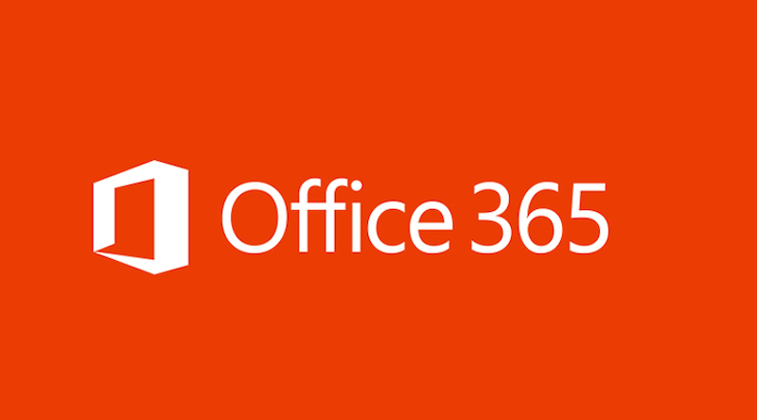
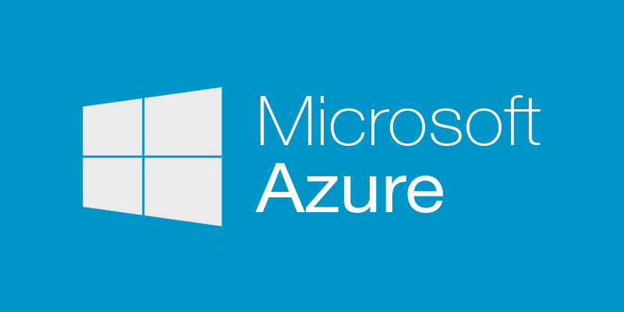
Better Together
Internet-only solution
Consistent authentication model
Single-vendor (easy to add to existing cloud strategy)
Take advantage of high-value platform services

Slide 7
Options for Compute

Slide 8

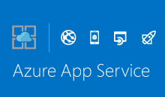
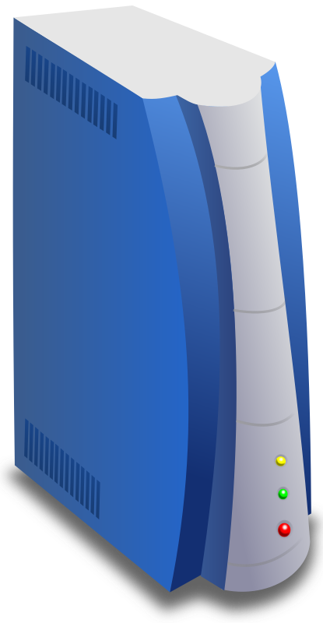

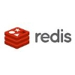
Azure
Corp WAN
Azure VNET
Azure Platform Services
Internal Subnet
DMZ Subnet
S2S VPN
Explicit
ExpressRoute
AD DS
AD FS
Web App Proxy
Internet
Internet

Slide 9
Virtual Machines
Cloud Services
Service Fabric
App Services
greater control / higher cost
lower cost / greater value

Slide 10

App Service Plan
Web Apps
LOGIC Apps
Mobile Apps
API Apps
Notes:
Web, API, and Mobile all built on the same core technology.

Slide 11

Develop apps with…
.NET
Python
Node.js
Java
PHP

Slide 12
Intelligent customer routing with Traffic Manager
www.yourapp.com

Slide 13
Staging

Slide 14
Testing in Prod.
80%
100%
20%

Slide 15
AutoScale

Slide 16
WebJobs

Slide 17
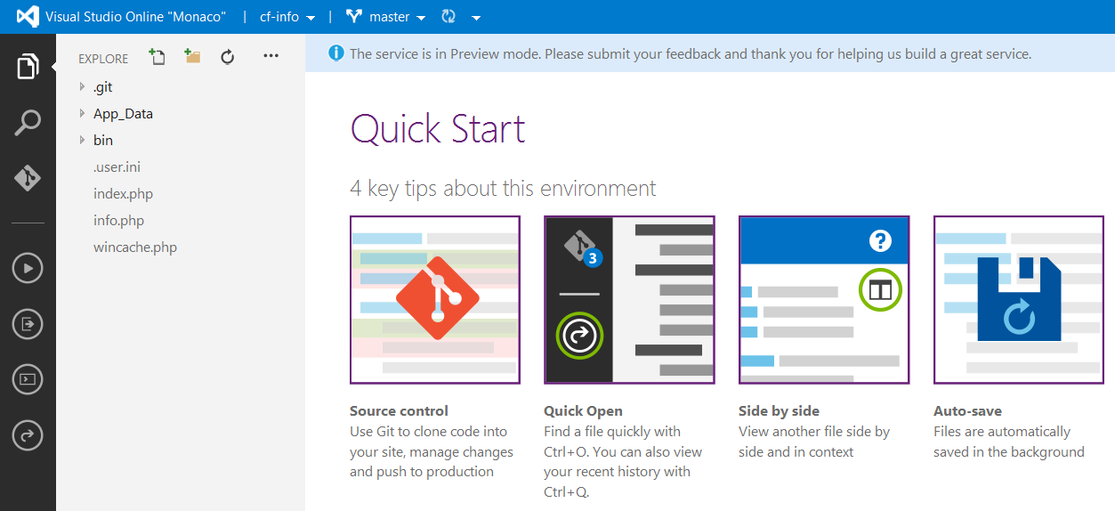
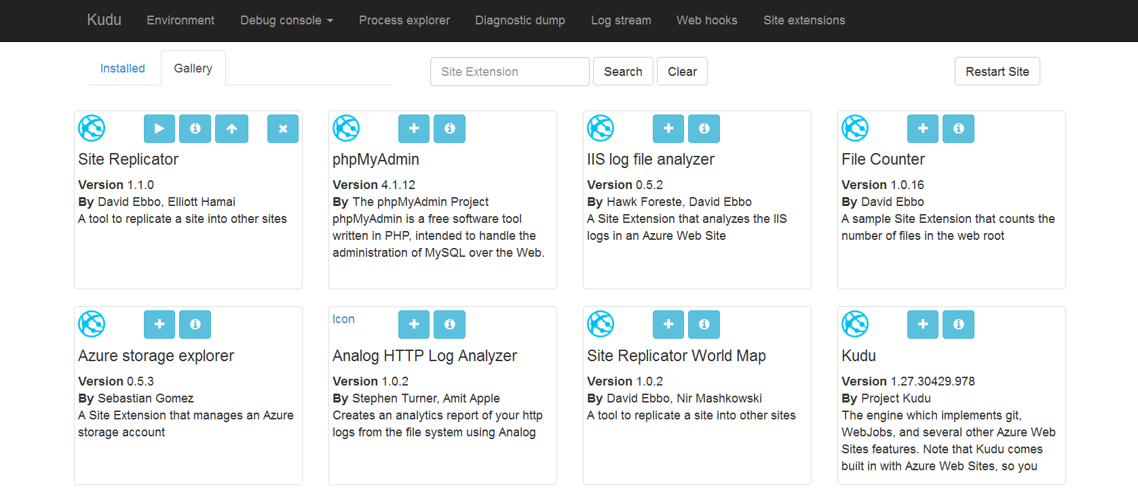
Site Extensions

Slide 18
In-depth app monitoring

Slide 19
Continuous Integration cycle
2) Code Repository
3) Build
4) Deploy to slot
5) Test
6) Swap
Azure
Contoso App
1) Developers
8) Monitor and Improve
7) Deploy to Cloud
Notes:
This is the whole (top level) Dev Ops story where Dev build wounderful apps, using CI they mange their code, builds, and releases. Connecting to a repository, they can deploy to Azure Websites, build in the cloud, deploy to a slot to test and validate, swap into production, deployed across the globe as needed, monitor and get feedback, on which devs can make updates. Rinse and repeat

Slide 20
Azure Service Fabric A platform for reliable, hyperscale, microservice-based applications
Reliable Actors API
Reliable Services API
Service Fabric
High Availability
Hybrid Operations
Health Monitoring
Self-healing
High Density
Rolling Upgrades
Stateful services
Low Latency
Replication & Failover
Hyper-Scale
Data Partitioning
Container Orchestration & lifecycle management
Load balancing
Simple programming models
Automated Rollback
Placement Constraints
Fast startup & shutdown
Azure
Private Clouds

Slide 21
Battle-hardened for over 5 years
Skype for Business
Hybrid Ops
Azure Document DB
billions transactions/week
Intune
800k devices
Azure Core Infrastructure
thousands of machines
Event Hubs
20bn events/day
Bing Cortana
500m evals/sec
Azure SQL Database
1.4 million databases
Power BI
Notes:
This platform has been battle hardened in our first party services for over 5 years
More importantly we are giving you not a version of the bits we use but the exact same bits that we run.
If you find bugs in this then we have those bugs also and will fix them
Azure core infrastructure itself runs on top of this platform
A transactionally consistent database service was built using this platform
Low-latency high throughput consumer facing service like Bing Cortana was built across 3 data centers using this technology. They recently lost an entire datacenter and the service didn’t blink

Slide 22
Orchestration of microservices during failure
Node 100
Node 101
Node 102
Node 103
Node 104
Node 105
P
S
P
P
S
P
S
S
S
S
S
S
P
S
P
S
S
S
S
S
S
S
S
S

Slide 23
Cloud Service
A container of related PaaS and or IaaS VM Instances
Web Role
Worker Role
IaaS VMs

Slide 24
Options for Storage

Slide 25
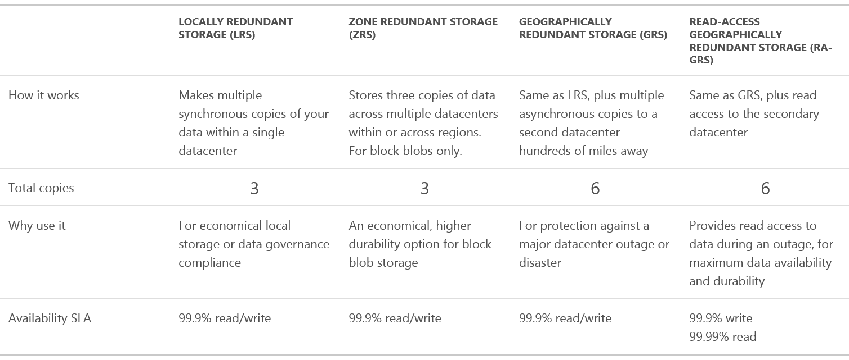
Blob Storage

Slide 26

Table Storage
Table Storage is used by applications requiring storing large amounts of data storage that need additional structure at no performance cost.
While a table stores structured data, it does not provide any way to represent relationships between the data, sometimes called a NoSQL database.
You can use SQL Azure for relational database service on Windows Azure.

Slide 27
Queues
Enables workflow between roles.
Queues are used for reliable, persistent messaging between applications.
You can use Queues to transfer messages between applications or services in Windows Azure.
Notes:
Slide Objectives
Understand the Value of Queues
Speaker Notes
Queues allow the apparent perf of app to be improved
Work can be buffered in queue and performed later
Allows simple async comms between roles
Notes
http://blogs.msdn.com/b/eugeniop/archive/2010/05/11/windows-azure-guidance-the-get-delete-pattern-for-reading-messages-from-queues.aspx

Slide 28
Windows Azure SQL Database
Managed Platform & Infrastructure
Dynamic Scalability
Fast & Flexible Platform
Based on SQL Server Technology
Fully managed (no patching of DB or OS)
Built in HA for Database 99.99% SLA
Simplified Azure Management Portal
Scale Out
Scale via Azure Management Portal
Rapid Application Development
Easy Database Portability
Familiar Development Tools
Global Deployment
Common Architecture with SQL Server
Insights with SQL Reporting

Slide 29
SQL service tiers
Feature | Basic | Standard |  |  |  | Premium
 |  | S0 | S1 | S2 | S3 | P1 | P2 | P4 | P6
Uptime SLA | 99.99% | 99.99% |  |  |  | 99.99%
Maximum Database Size | 2 GB | 250 GB |  |  |  | 500 GB
Database Throughput Units (DTU) | 5 | 10 | 20 | 50 | 100 | 125 | 250 | 500 | 1000
Point in Time Restore | Any point in last 7 days | Any point in last 14 days |  |  |  | Any point in last 35 days
Disaster Recovery | Geo-Restore, restore to any Azure region | Standard Geo-Replication, offline secondary |  |  |  | Active Geo-Replication, up to 4 online (readable) secondary backups
Performance Objectives (Benchmark Transaction Rate) | Transaction rate per hour | Transaction rate per minute |  |  |  | Transaction rate per second
 | 16,600 | 521 | 934 | 2570 | 5100 | 105 | 228 | 447 | 735
Max Worker Threads | 30 | 60 | 90 | 120 | 200 | 200 | 400 | 800 | 1600
Max Sessions | 300 | 600 | 900 | 1200 | 2400 | 2400 | 4800 | 9600 | 19200
Comparative TPM | 276 | 521 | 934 | 2570 | 5100 | 6300 | 13680 | 26820 | 44100
The Basic, Standard, and Premium service tiers offer differing feature sets, so the first step in selecting an appropriate tier is to determine the service tier that provides the minimum level of feature capabilities required for your application and business.

Slide 30
Azure DocumentDB
fully managed NoSQL document database service built for the cloud
Flexible schema for iterative application development
Automatic indexing with a SQL interface
Transactional support for multi-document operations
Scalable database storage with predictable performance
Characteristics
Partitioned for scale out
Replicated for HA
RESTful interaction over HTTP
HTTP and TCP connectivity
Documents
Application defined JSON
No enforced schema
All properties indexed by default
Optimized for many small documents

Slide 31
Considerations
Azure SQL DB has the most robust Business Continuity / Disaster Recovery options.
Azure Storage and DocumentDB .NET clients already handle transient failures; you must implement something for Azure SQL DB.
Consider Azure Table Storage and DocumentDB for object serialization.
DocumentDB can reduce code due to projection.
DocumentDB can increase code related to serialization for non-supported types (ex. timestamp).
Azure Table Storage and DocumentDB are much faster than Azure SQL DB.
High performance Azure SQL DB can be achieved via sharding.
Many reporting solutions will only be able to connect to Azure SQL DB.

Slide 32
SharePoint Apps

Slide 33
SharePoint App Categories
Custom look-and-feel
Interface with SharePoint-only data
Multi-tiered application
Scheduled tasks
Landing page
Custom event receiver
Interface by email (no demo)
Mobile (no demo)
Forms (no demo)

Slide 34
Custom LOOK-and-feel
SharePoint-Hosted App
UserCustomAction – applies to all Webs in a Site
customui.js hosted in Azure - allows global changes

Slide 35
Interface with SharePoint-Only Data
SharePoint-Hosted App
JSOM-only

Slide 36
Multi-Tiered Application
SharePoint-Hosted App
Guiding Principals
Approach as a web app, not a SharePoint app. Feel free to use Node.js, Java, etc.
JSOM for everything the user needs to do. CSOM only for system tasks.
Web API services hosted as an Azure Web App (Startup.cs)
Make sure you Install-Package Microsoft.Owin.Host.SystemWeb
Authenticated via ADAL.JS and Azure AD
App Part requests token from parent page (implemented in Custom UI)

Slide 37
Scheduled Tasks
Web Job in Azure Web App (recommend separate Web App)
Leverages Azure Queue
Credentials/Connection Strings stored in Azure Web App Connection Strings
Can be scheduled

Slide 38
Landing Page
SharePoint-Hosted App to deploy files
Content Editor Web Parts based on files in Site Assets
Authentication via JWT stored in Property Bag (deployed by scheduled task)
Authorization via Claims in tokens

Slide 39
Custom Event Receiver
https://xxxx.sharepoint.com/_layouts/15/appregnew.aspx (register app)
Provider-Hosted App (but no associated Web Site)
Put Client ID and Client Secret in web.config (or better, modify TokenHelper)
Create a SOAP endpoint
Authenticate and authorize using ClientContext
Important: The event registration MUST be made using a SharePoint App’s Context and it can only be removed by the exact same App.

